Slide 1

STATIC AND MODAL ANALYSIS OF LEAF SPRING USING FEA
PROJECT PRESENTATION
GROUP MEMBERS
SHASHI KAPOOR VERMA
MAYANK SINGH
Guided by
DR. HEMANT SINGH
DEPARTMENT OF MECH ENGG.
UNSIET , VBSPU JAUNPUR

Slide 2
CONTENTS
Introduction
Research motivation
Objectives of the work
Literature review
Modeling
Analysis
Result
Conclusion
References

Slide 3
INTRODUCTION
A leaf spring is a simple form of spring commonly used for the suspension in wheeled vehicles.
The suspension system in automobiles is a very important component in deciding vehicle drive comfort and the stability of the vehicle.
A leaf spring can either be attached directly to the frame at both ends or attached directly at one end.
A leaf spring commonly used in automobiles is semi–elliptical assembly. It is built with number of curves plates.

Slide 4
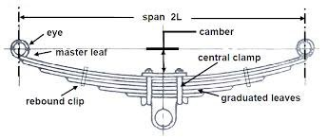
LEAF SPRING
Fig. 1

Slide 5
RESEARCH MOTIVATION
The automobile industries are showing increasing interest in replacement of steel spring with composite materials like fiber glass composite leaf spring due their higher strength to weight ratio.
Composite leaf spring are lighter and stronger compared to ordinary steel leaf spring.
The spring is intended to bear heavy jerks and vibrations and provide drive comfort and the stability of the vehicle.

Slide 6
objective
This project aims at comparative study of design parameters of a traditional steel leaf spring assembly and composite leaf spring with bonded end joints.
By performing static analysis using ANSYS software and mathematical calculations, the maximum bending stress and corresponding payload.
By performing modal analysis using ANSYS software and mathematical calculations, the natural frequencies are compared with the excitation frequencies at different speeds of the vehicle with the various widths of the road irregularity.

Slide 7
LITRATURE REVIEW
M.VENKATESAN , D.HELMEN DEVARAJ [7] perform design and experimental analysis of composite leaf spring made of glass fiber reinforced polymer & compare the load carrying capacity, stiffness and weight savings of composite leaf spring with that of steel leaf spring. Compared to steel spring, the composite leaf spring is found to have 67.35% lesser stress, 64.95% higher stiffness and 126.98% higher natural frequency than that of existing steel leaf spring. A weight reduction of 76.4% is achieved by using optimized composite leaf spring.

Slide 8
Gulur Siddaramanna SHIVA SHANKAR [5] performed test on the leaf springs under static loading condition & the stresses and deflection are listed. These results are also compared with FEA. Testing has been done for unidirectional E-Glass/Epoxy mono composite leaf spring only. Since the composite leaf spring is able to withstand the static load, it is concluded that there is no objection from strength point of view also, in the process of replacing the conventional leaf spring by composite leaf spring.

Slide 9
modeling
Specification
The following are the model dimensions.
1. Camber = 80mm
2. Span = 1220mm
3. Thickness of leaves = 7mm
4. Number of leaves = 10
5. Number of full length leaves nF = 2
6. Number of graduated length leaves nG = 8
7. Width = 60
8. Ineffective length = 60mm
9. Eye Diameter = 20mm
10. Bolt Diameter = 10mm

Slide 10
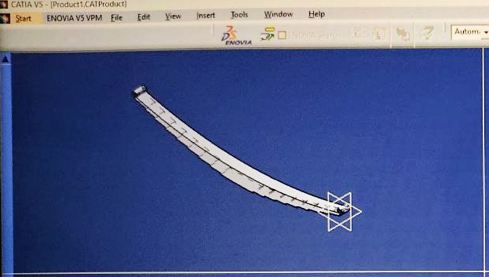
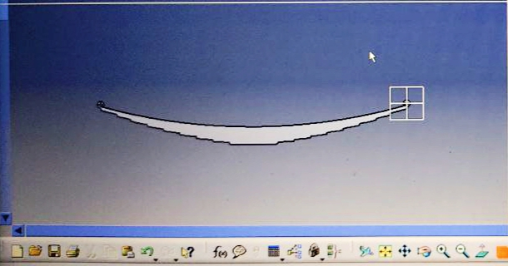
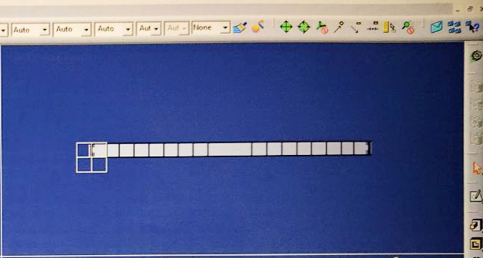
Fig. 2 Isometric view
Fig. 3 Side view
Fig. 4 Top view

Slide 11
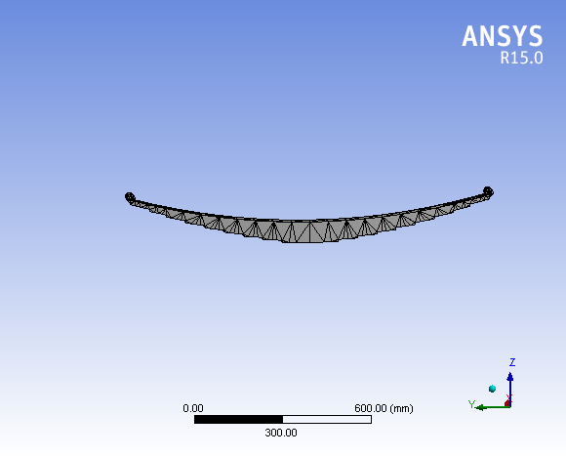
analysis
Element Type
1. For steel leaf spring brick 20 node95.
2. For mono composite leaf spring Shell 99 linear layer 99
Meshing
Loading
Boundary conditions
Fig. 5

Slide 12
Material
A. Steel spring.
Material = Manganese Silicon Steel Young’s modulus E = 2.1 E5 N/mm2 Density þ= 7. 86 E – 6 kg/mm3 Poisson’s ration = 0.3 Yield Stress = 1680 N/ mm2.

Slide 13
B. Composite leaf spring.
Material = Carbon epoxy Young’s modulus E = 1.34E11 N/mm2 Density þ= 1600 Kg/mm3 Poisson’s ration = 0.2 Shear modulus = 5.8e9 N/mm2

Slide 14
C. New composite leaf spring.
Material = E-Glass/Epoxy Young’s modulus E = 1.396E10 N/mm2 Density þ= 1833 Kg/mm3 Poisson’s ration = 0.22 Shear modulus = 5.72e9 N/mm2

Slide 15
Static and modal analysis
Static analysis determines the safe stress and corresponding pay load of the leaf spring and also to study the behavior of structures under practical conditions. The present work attempts to analyze the safe load of the leaf spring, which will indicate the speed at which a comfortable speed and safe drive is possible.
Every object has an internal frequency (or resonant frequency) at which the object can naturally vibrate the result of modal analysis are these frequencies at which the amplitude increases to infinity which tends to failure of the system.

Slide 16
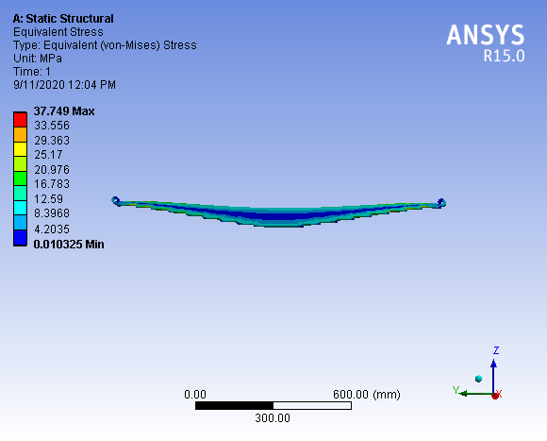
RESULT
FOR STEEL LEAF SPRING
Von- mises stress
Fig .6 For 2000 N load

Slide 17
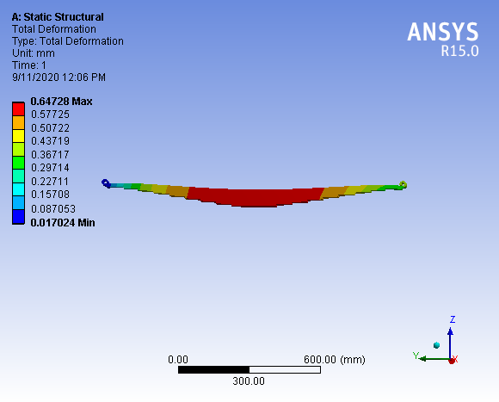
Deformation
Fig. 7 For load 2000 N

Slide 18
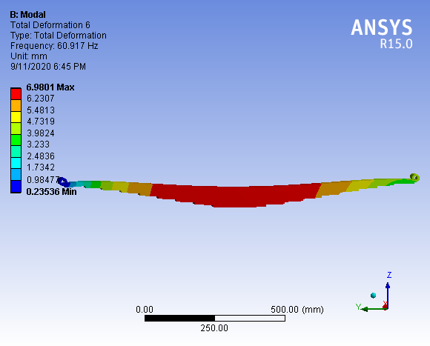
For Modal analysis
Fig. 8 For node 1

Slide 19
RESULT table
For Von mises stress(N/mm2)
Materials | Theoretical values | Research paper observation |  | Our observation
 |  | Steel spring | Carbon spring | Steel spring | Carbon spring | E Glass spring
2000 N | 266 | 339 | 228.4 | 37.7 | 40.25 | 39.74
4000 N | 533 | 679 | 411.2 | 75.4 | 80.51 | 79.46

Slide 20
RESULT table
For Deformations (mm)
Materials | Research paper observation |  | Our observation
 | Steel spring | Carbon spring | Steel spring | Carbon spring | E Glass spring
2000 N | .49 | .287e-5 | .64 | 1.01e-6 | 9.72e-6
4000 N | .75 | .575e-5 | 1.29 | 2.033e-6 | 1.94e-5

Slide 21
Modal results
Mode | Frequency [Hz]
1. | 60.917
2. | 79.652
3. | 172.28
4. | 344.21
5. | 388.75
6. | 473.51

Slide 22
conclusion
The leaf spring has been modeled using solid tetrahedron 4 – node element. By performing static analysis it is concluded that the maximum safe load is 4000 N for the given specification of the leaf spring.
We are still working no the project…

Slide 23
references
Eliahu Zahavi The Finite Element Method in Machine Design. Prentice Hall, Englewood Cliffs, N.J, 07632.
en.wikipedia.org/wiki/Leaf_spring
R. K. Rajput Text Book Of Automobile Engineering, Page No. 419, 420.
SAE manual on design and application of helical and spiral springs Society of Automotive Engineers 4th Edition, ISBN10: 0898833833 ISBN-13: 9780898833836 1999.
Ansys Advance Analysis Techniques guide Ansys Release 10.0, August 2005.

Slide 24
THANKS…

